Slide 1

Project 0
Bank 4 Your Buck

Slide 2

Overview
Design
Security
Demo

Slide 3
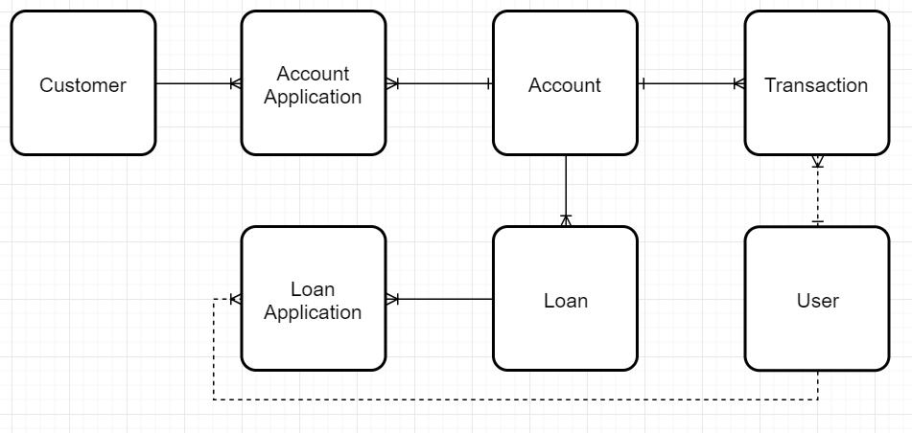
ERD

Slide 4
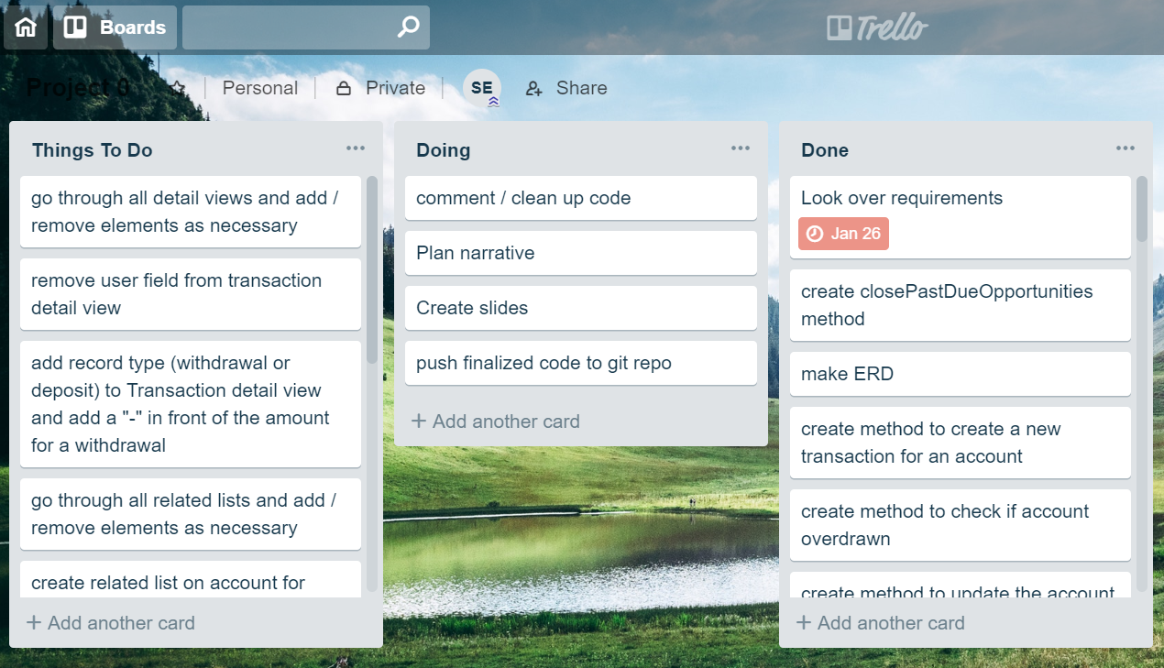
Trello

Slide 5
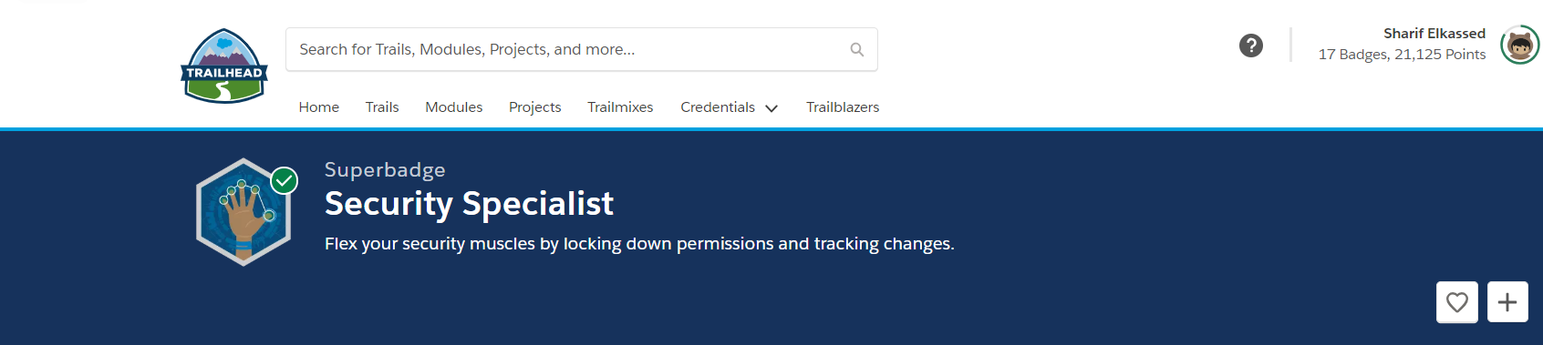

Superbadge

Slide 6
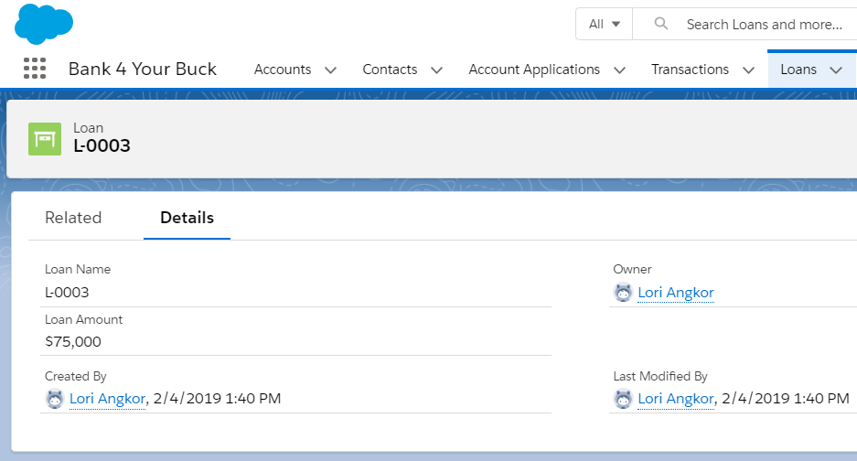
Teller
Loans read-only
Loan application read-only
Access to all transactions and accounts

Slide 7
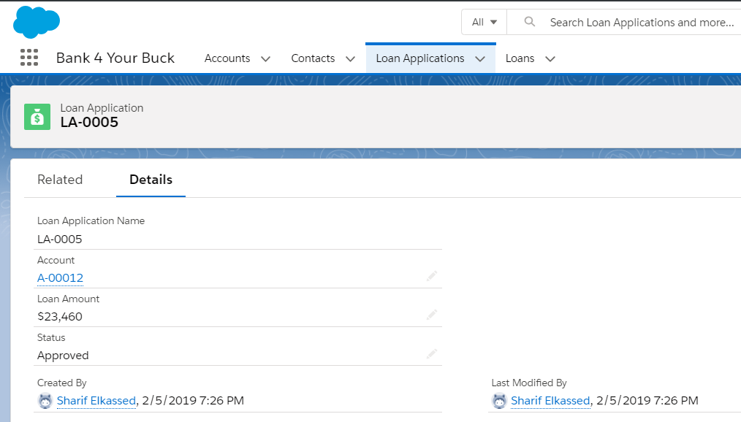
Loan Officer
No access to Transactions
CRED permissions for Loans/Applications
Access to Accounts, but not Applications

Slide 8

Demo

